Slide 1
Seerah
سيرۃالنبيﷺ

Slide 2
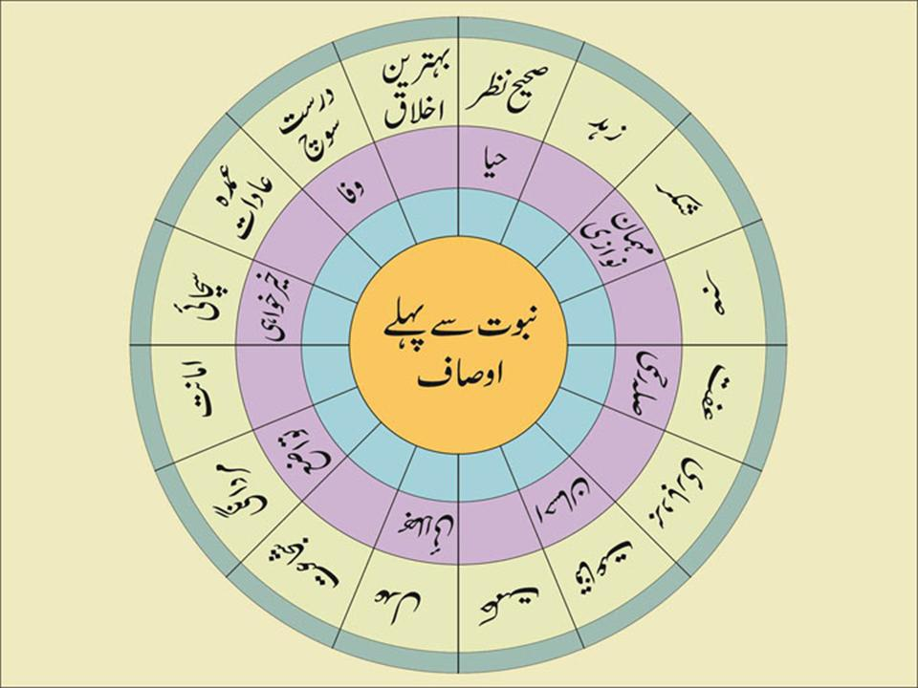

Slide 3
In the Shade of the Message and Prophet hood

Slide 4
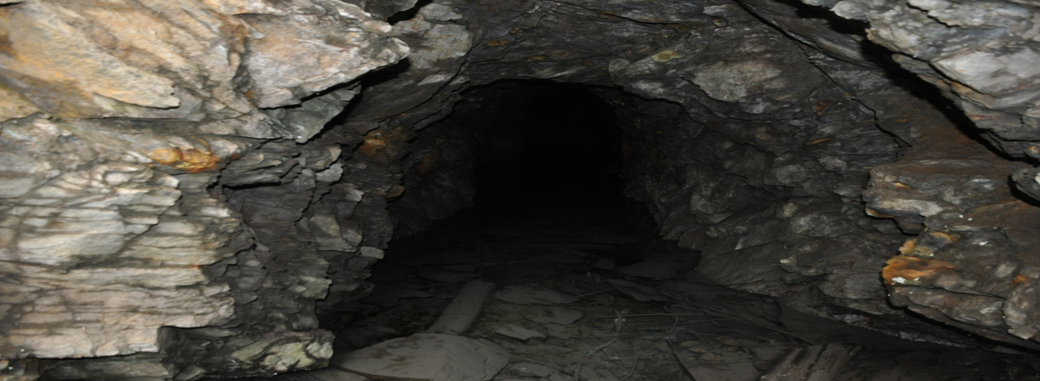
In the cave of Hira
When Prophet Muhammad was nearly forty, he started to pass long hours in retirement in hills around Makkah, meditating and speculating over all aspects of creation around him.

Slide 5
his favorite resort — a cave named Hira’, in the Mount An-Nour.
جبل النور

Slide 6
Jabal e Noor

Slide 7
Cave of Hira

Slide 9
His heart was restless about the moral evils and idolatry that were rampant among his people.
He was as yet helpless because no definite course, or specific approach had been available for him to follow and rectify the ill practices around him

Slide 10
Privacy and detachment from the impurities of life were two indispensable prerequisites for the Prophet’s soul to come into close communion with the Unseen Power that lies behind all aspects of existence in this infinite universe.
This rich period of privacy lasted for three years and then ushered in a new era of indissoluble contact with that Power.

Slide 11
Gabriel brings down the Revelation
When Prophet (pbuh) was forty, the age of complete perfection at which Prophets were always ordered to disclose their Message, signs of his Prophet hood started to appear in the form of true visions.

Slide 12
It was the night of 21st Ramadan, August 10th, 610 A.D. when angel Gabriel brought the first three ayahs of Surah Alaq, as the first revelation
ٱقۡرَأۡ بِٱسۡمِ رَبِّكَ ٱلَّذِى خَلَقَ

Slide 13
Prophet (pbuh) repeated these verses after Gabriel.
He was trembling with fear when he came back to his wife Khadijah, and said, "Cover me, cover me." She covered him until he restored security.
He told Khadijah of the incident of the cave and added that he was afraid.

Slide 14
Khadijah the Great
His wife tried to soothe and reassure him by saying, "Allâh will never disgrace you. You unite uterine relations, you bear the burden of the weak; you help the poor and the needy, you entertain the guests and endure hardships in the path of truthfulness."

Slide 15
She took him to her cousin Waraqa bin Nawfal, who had embraced Christianity in the pre-Islamic period, and used to write the Bible in Hebrew. He was a blind, old wise man.
When prophet told him everything that he hadwitnessed, Waraqa replied: "This is ‘Namus’ i.e. (the angel who is entrusted with Divine Secrets) that Allâh sent to Moses.”

Slide 16
Waraqa said “I wish I were younger. I wish I could live up to the time when your people would turn you out." Muhammad (pbuh) asked: "Will they drive me out?" Waraqa confirmed and said: "Anyone who came with something similar to what you have brought was treated with hostility; and if I should be alive till that day, then I would support you strongly." A few days later Waraqa died and the revelation also subsided.

Slide 17
Interruption of Revelation
Ibn Sa‘d reported on the authority of Ibn ‘Abbas that the Revelation paused for a few days, after the first revelation, though prophet saw Gabriel once or twice even after that.
The Prophet was caught in a sort of depression, coupled with astonishment and perplexity.

Slide 18
Second revelation
Prophet himself told in one of the ahadith "While I was walking, I heard a voice from the sky. I looked up, and surely enough, it was the same angel who had visited me in the cave of Hira’. He was sitting on a chair between the earth and the sky. I was very afraid of him and knelt on the ground. I went home saying: ‘Cover me …, Cover me …”.

Slide 19
Allâh revealed the verses:
يَـٰٓأَيُّہَا ٱلۡمُدَّثِّرُ
قُمۡ فَأَنذِرۡ
وَرَبَّكَ فَكَبِّرۡ
وَثِيَابَكَ فَطَهِّرۡ
وَٱلرُّجۡزَ فَٱهۡجُرۡ

Slide 20
You (Muhammad) enveloped (in garments)! Arise and warn! And your Lord (Allâh) magnify! And your garments purify! And keep away from Ar-Rujz (the idols)!’" [Al-Qur'an 74:1-5]

Slide 21
As the revelation begins
What was to preach

Slide 22
Surah Al-Muddaththir
O you (Muhammad SAW) enveloped in garments! (1) Arise and warn! (2) And magnify your Lord (Allâh)!

Slide 23
Warn and magnify your Lord
Allah is the only one worthy of worship and Praise.
one who refuses to accept this undeniable reality should be warned of the serious consequences.

Slide 24
The constituents of the call
Testimony to the Oneness of Allâh.
Belief in the Hereafter.
Sanctifying one’s soul and elevating it high above evils
Committing one’s all affairs to Allâh, the All-High.
Life becomes the replica of prophet’s (pbuh) life

