Slide 5
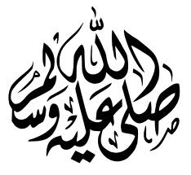

Slide 9
Reason behind extreme hatred and animosity
Pride & Jealousy

Slide 10
Reason behind extreme hatred and animosity
Prejudice & Ignorance

Slide 11
Musab bin Umair(Ra)
Tortured by his own mother

Slide 12
Bilal bin Reba(Ra)
Moazzan e Rasool (saw)

Slide 13
Family of Yasir(Ra)
First martyr of
Islam

Slide 14
Khabab bin Arath(Ra)
Arab Slave

Slide 19
Why did Allah (swt) put the early Muslims through extremely difficult trials?

