Slide 1
Seerah
سيرۃالنبي

Slide 2
Why Allah chose Arabs

Slide 3
Highly Praiseworthy Virtues
Hospitality
Keeping a covenant
Sense of honour and rejection of injustice
Firm will and determination
Forbearance, perseverance and mildness
Pure and simple Bedouin life

Slide 4
The Prophetic Family

Slide 6
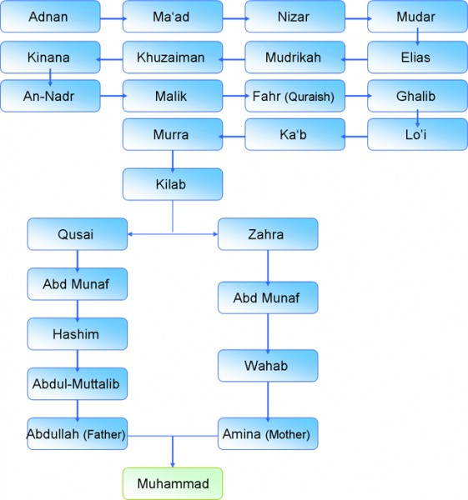
Qidar

Slide 7
The Prophetic Family
Hashim
Abdul-Muttalib
Abdullah

Slide 8
Hashim great grand father
The family of Prophet Muhammad is called the Hashimite or banu Hashim, after his great grandfather Hashim bin ‘Abd Munaf
he was the one responsible for giving food and water to the pilgrims.
He was wealthy and honest man.
His first name was ‘Amr but he was called Hashim because he started the practice of crumbling bread (for the pilgrims).

Slide 9
Abdul-Muttalib grand father
Abdul-Muttalib was in charge of pilgrims’ food and water and was well respected amongst Quraish.
he witnessed two important events in his lifetime, namely digging of the Zamzam well and the year of the Elephant.

Slide 10
Digging of the zam zam
Abdul-Muttalib received an order in his dream to dig Zamzam well in a particular place. He did that and found the things that Jurhum men had buried therein
He found the swords, armours and the two deer of gold
then the tradition of providing Zamzam water to pilgrims was established.

Slide 11
When the well of Zamzam gushed water forth, in the hands of Abdul-Muttalib and his prerogative as regards the sacred spring was established, he made a solemn vow to sacrifice one of his adult children to Al-Ka‘bah if he had ten.

Slide 12
THE YEAR OF THE ELEPHANT
Abraha, (Ethiopian) viceroy in Yemen decided to demolish kaabah.
But Allaah saved kaabah by sending birds carrying small stones in their beaks which destroyed the army

Slide 13
This incident is mentioned in surah Al-fil in Quran
أَلَمۡ تَرَ كَيۡفَ فَعَلَ رَبُّكَ بِأَصۡحَـٰبِ ٱلۡفِيلِ
Have you not seen how your Lord dealt with the Owners of the Elephant?

Slide 14
The Event of the Elephant took place in the month of Al-Muharram, fifty or fifty five days before the birth of Prophet Muhammad (Allah bless him and give him peace) which corresponded to late February or early March 571 A.D. It was a gift from Allâh to His Prophet and his family.

Slide 15
News of the Elephant event reached the most distant corners of the world
The Elephant Raid Event riveted the world’s attention to the sacredness of Allâh’s House, and showed that this House had been chosen by Allâh for its holiness

Slide 16
Abdullah
Abdul-Muttalib had ten sons and Abdullah was the smartest of all, the chastest and the most loved
He was the one chosen for the sacrifice that
Prophet once said:
"I am the offspring of the slaughtered two," meaning Ishmael and ‘Abdullah.

Slide 17
Mother of the Prophet
Abdul-Muttalib chose Amina, daughter of Wahab bin ‘Abd Munaf, as a wife for his son, ‘Abdullah. She in the light of this ancestral lineage, stood eminent in respect of nobility of position and descent.
Abdullah the prophet s father died two months before his birth

Slide 18
His Birth
9 Rabi‘ Al-Awwal,
20th of April, 571 A.D.

Slide 19
Childhood
It was the general custom of the Arabs to send their children away to Bedouin wet nurses, so that they might grow up in the free and healthy surroundings of the desert and acquire the pure language who, even in those times were free from common cultural vices.

Slide 20
When prophet was only six years old his mother died during the journey to madina
His grandfather Abdul-muttalib took the charge of his well being.
But When he was only eight years old, his grandfather also passed away

Slide 21
The charge of the Prophet was now passed on to his uncle Abu Talib,
who was the brother of the Prophet’s father.
Abu Talib remained for forty years cherishing his nephew and extending all
possible protection and support to him

Slide 23
Al-Fudoul Confederacy
At the conclusion of the 'Sacrilegious’ Wars when peace was restored, people felt the need for forming confederacy at Makkah for suppressing violence and injustice, so some of the quraish tribes entered into peace treaty of which prophet was a witness.

Slide 24
Muhammad’s Early Job
It is reported that he worked as a shepherd for Bani Sa‘d and Quraish.
Quraish people were mostly traders. At the age of 25, Prophet (pbuh) also went to Syria as a merchant for Khadijah [R].

Slide 25
Muhammad ﷺ and khadijah Timeless love story

Slide 26
His Marriage to Khadijah
Khadijah was a business-woman of great honour and fortune.
After the return of Muhammad (pbuh) from his trade journey for Khadija (RA), she was told about Muhammad’s good manners, honesty, deep thought, sincerity and faith.

Slide 27
His Marriage to Khadijah
She realized that she had found her soulmate.
She disclosed her wish to her friend, who immediately went to Muhammad and broke the good news to him.
He agreed and requested his uncles to meet Khadijah’s uncle and talk about the proposal.
Subsequently, they were married.

Slide 29
His Marriage to Khadijah
He gave her twenty camels as dowry.
At the time of marriage, he was twenty five and she was forty years old and was considered as the best woman of her folk in lineage, fortune and wisdom.
She was the first woman whom the Messenger of Allâh (pbuh) married.
He did not get married to any other woman until she had died.

Slide 30
Khadijah and Muhammad
5 out of their 6 children, except Fatimah, died during his lifetime. Fatimah died six months after his death.
All his daughters witnessed Islam, embraced it, and emigrated to Madinah.

Slide 31
Rebuilding Al-Ka‘bah
When the Messenger of Allâh was thirty five, Quraish started rebuilding Al-Ka‘bah.
The chiefs of Quraish decided to use only licit money in rebuilding Al-Ka‘bah, so all money that derived from prostitution, singing and dancing, usury or unjust practices or immoral means was excluded.

Slide 32
Muhammad in his youth
Prophet Muhammad (pbuh) was a combination of the best social attributes.
An exemplary man of weighty mind and faultless insight.
Favoured with intelligence, originality of thought and accurate choice of the means leading to accurate goals.

Slide 33
