Slide 1
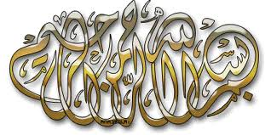
سيرۃالنبي
Seerah

Slide 2
What is Seerah?
Seerah comes from the Arabic word ‘sara’ or ‘yaseero’ ”س۔ر۔ی“ means journey or traveling.

Slide 3
Seerah of prophet Muhammad
It is commonly restricted to the life and events of prophet Muhammad
His lineage and the events leading up to his birth,
Events and circumstances during his life time
His death and events occurred after
It also includes the events of the past or early generations in Islam.

Slide 4
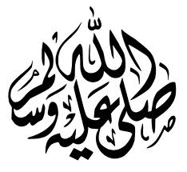
Seerah generally means the biography of
Prophet Muhammad

Slide 5
WHO WAS
وَمَا أَرْسَلْنَاكَ إِلَّا
رَحْمَةً لِلْعَالَمِينَ

Slide 6
Most respected, loved and followed Human being ever
There has never been a person who has changed world history so dramatically as Muhammad and his message.
Prophet Muhammad was the single most important person in the history of the world.

Slide 7
Muhammad was and will always be the greatest man who ever stepped on the face of the earth.

Slide 8
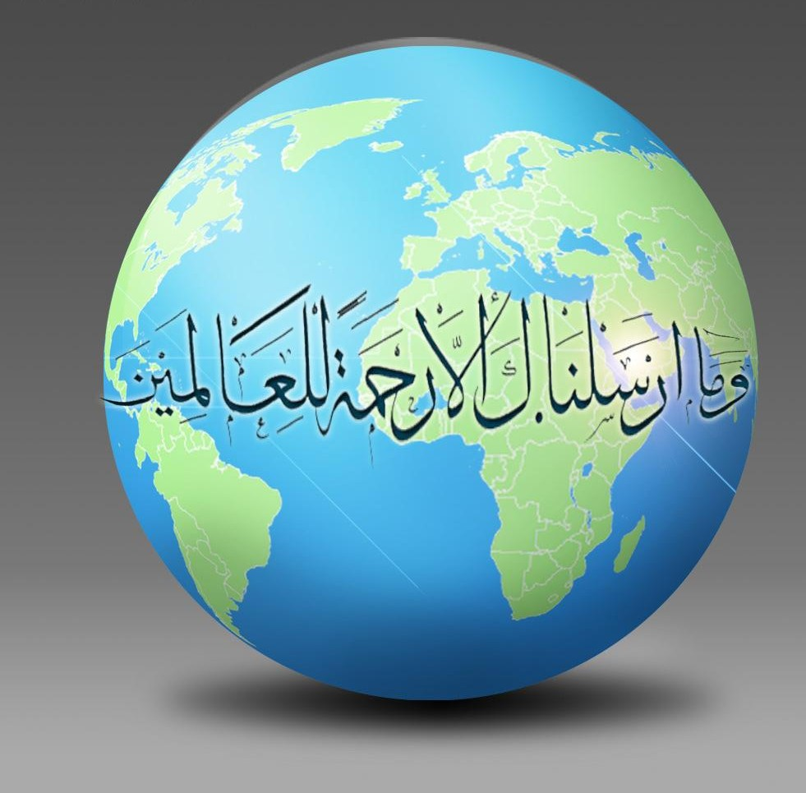
What the world says about him

Slide 9
Encyclopedia Britannica
". . . a mass of detail in the early sources shows that he was an honest and upright man who had gained the respect and loyalty of others who were likewise honest and upright men." (Vol. 12)

Slide 10
“ he was the only man in history who was supremely successful on both the religious and secular level."
Michael H. Hart, THE 100: A RANKING OF THE MOST INFLUENTIAL PERSONS IN HISTORY, New York: Hart Publishing Company, Inc., 1978, page. 33.

Slide 23
Seerah?
Why should we learn

Slide 24
Love for the Prophet(s)is a Condition of Faith
"None of you becomes a believer until I am dearer to him than his children, his parents and all mankind."
(Bukhari and Muslim)

Slide 25
Allah commands us to follow the example of the Prophet
Certainly you have in the Messenger of Allah an excellent exemplar for him who hopes in Allah and the last day and remembers Allah much. Surat Al-Ahzab (33) Verse 21
لَقَدۡ كَانَ لَكُمۡ فِى رَسُولِ ٱللَّهِ أُسۡوَةٌ حَسَنَةٌ

Slide 26
Perfect role model in all walks of life
No matter, what situation you are dealing with in life, you have a perfect example of leadership, success, mercy, compassion, care, consideration, kindness and tolerance in the character of Prophet Muhammad.

Slide 27
It raises our hopes and gives us optimism
especially in the time of trouble and turmoil. We are not the only ones suffering rather it has happened before and in more extreme manners.

Slide 28
For the revival of Muslim Ummah
How to bring about the honor and glory that we once had.
How he started in the middle of the most illiterate society and within two decades he controlled all of Arabia. And in another two decades after his death, Muslims reign was spread from Spain to china!
How did that happen, what were the stages that it went through?

Slide 29
He was a living Quran
There is absolutely NO way we can understand Quran without learning seerah.
Seerah is one of the most important sciences of Quran.

Slide 30
Studying seerah is ibadah
Studying seerah is essential for helping us develop an Islamic identity and character
We must know the seerah to know our roots
For better mannerism
To defend the honour of our prophet (s)

Slide 31
Three different aspects of learning seerah
Learn it as a history subject and emphasize more on dates, names and events.
Learn it to get the best examples and lessons for one s own better life and greater reward in the hereafter
To increase the love of
Prophet Muhammad

Slide 32
Sources of Seerah
1. The Qur’an
2. The Books of Hadeeth
3. The Classical Books of Seerah
Seerat Ibn Is’haq.
Seerat Ibn Hisham
Al-Bidaya wa'l-Nihaya
Fiqh u seerah
Old Arab traditions
The Books of History

Slide 33
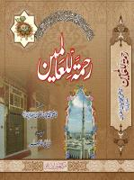
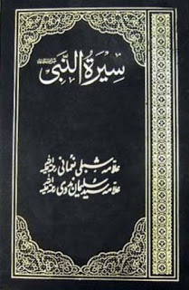
Popular books on Seerah

Slide 34
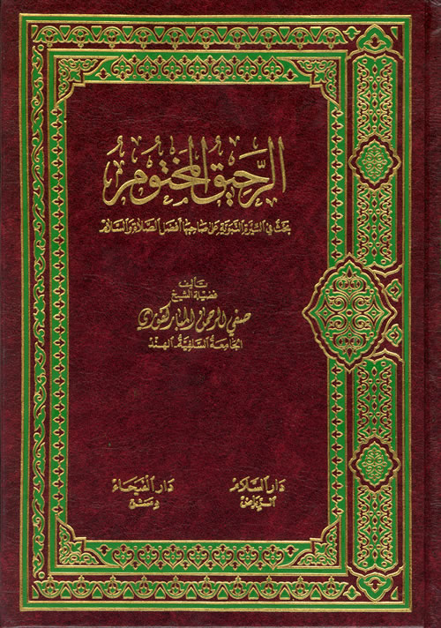
Writer : Safiur-Rahman Al-Mubarakpuri
This book was awarded First prize by the Muslim world League in world wide competition on the Biography of prophet Muhammad held at Makkah Al-Mukarramah in 1979

