Slide 1
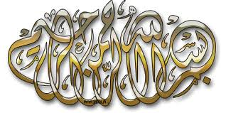
سيرۃالنبي
Seerah
2

Slide 2
عرب محل وقوع اور قومیں
Location and Nature of Arab tribes

Slide 6
The ancestry of Prophet Muhammad (s)goes back to almost 4000 years ago to Prophet Abraham (Pbuh) from a town called “Ar” near Kufa on the west bank of the Euphrates in Iraq.

Slide 7
Journeys of Abraham
It is known that Abraham (Peace be upon him) left “ur” for Harran and traveled to Palestine, to spread the message of Allah and chose Jerusalem as a central place for religion.

Slide 8
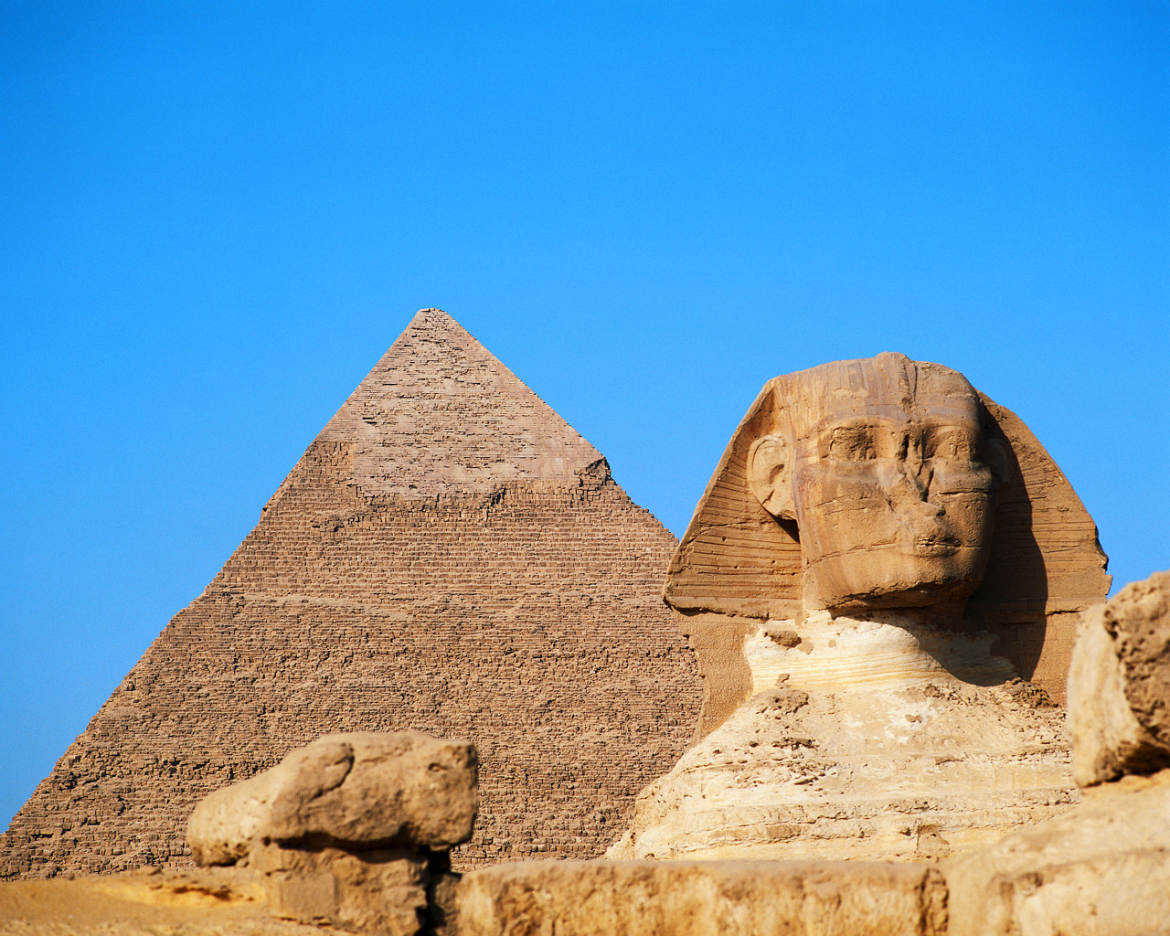
Abraham, Sarah and Hagar (a.s)

Slide 9
Abraham reaches Makkah
Hagar gave birth to Ishmael. And while Ishmael was still a small baby Allah commanded Abraham to send Hagar and her baby away to a plant less valley on a small hill in Hijaz, by the Sacred House.

Slide 10
Hagar, Ismael & Zam Zam

Slide 11
Population of Makkah grows
After them a Yemeni tribe “Jurhum” came and lived in Makkah upon Hagar’s permission.

Slide 12
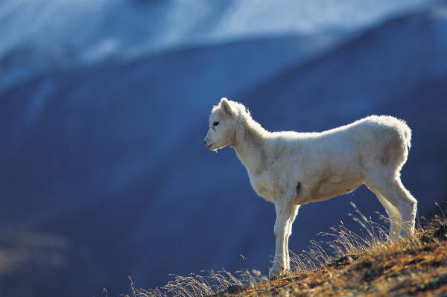
Sacrifice of Ismael

Slide 13
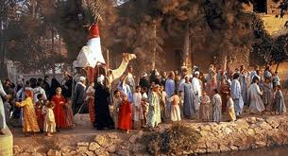
Marriage of Ismael in Jurhum tribe

Slide 14
Building of Ka’abah

Slide 16
Genealogy of Prophet Muhammad
By the grace of Allâh, Ishmael had twelve sons from the daughter of the leader of jurhum tribe.
Descendants of Qidar, the son of Ishmael, lived long in Makkah increasing in number, of them issued ‘Adnan to whom ‘Adnanian Arabs traced back their ancestry.

Slide 17
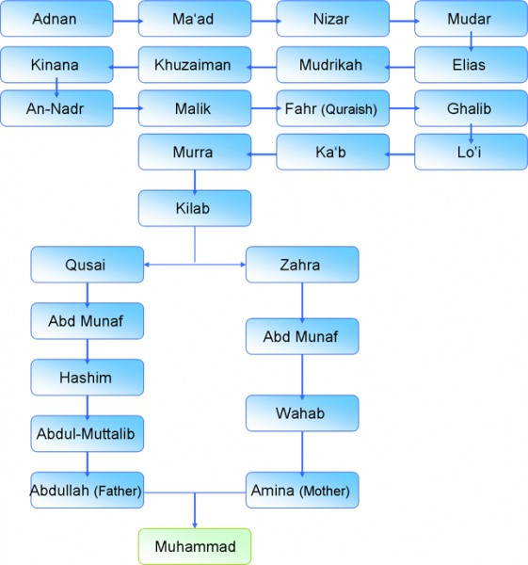
Qidar

Slide 18
Prophet Muhammad said: “Allâh selected Ishmael from the sons of Abraham, Kinana from the sons of Ishmael, Quraish from the sons of Kinana, Hashim from the sons of Quraish and He selected me from the sons of Hashim.”

Slide 19
Messenger of Allâh (s) as saying “Allâh created mankind and chose me from the best whereof, He chose the tribes and selected me from the best whereof; and He chose families and selected me from the best whereof. I am the very best in person and family.”

Slide 20
Aspects of Pre Islamic Arabs

Slide 21
The Political Situation
Before Islam there were two kinds of rulers:
Crowned Kings
Heads of Tribes and Clans

Slide 22
The Political Situation
Crowned Kings
Yemen
Syria
Ghassan
Heerah

Slide 23
Heads of Tribes and Clans
The tribe heads were chosen by the whole tribes.
The heads enjoyed dictatorial privileges similar to those of kings and were rendered full obedience in both war and peace.

Slide 24
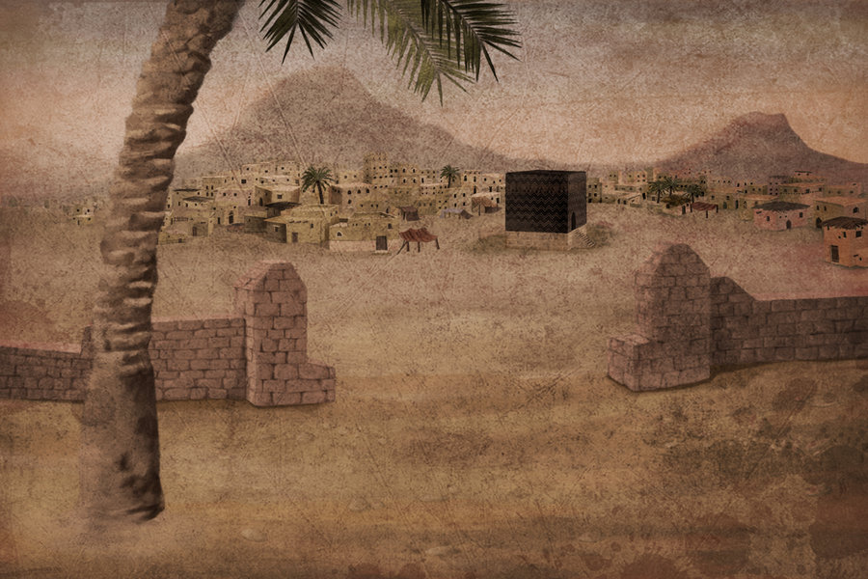
Rulers of Hijaz
They were greatly esteemed and respected by the Arabs and were considered as rulers and servants of the religious center as they were the guardians of Ka’aba, House of Allah.

Slide 25
Social Situation
Social differences
People were divided only in two groups, master or slaves, Rulers or sub-ordinates.
The slaves and sub-ordinates were in extremely bad situation suffering from ignorance, oppression, inequity, injustice and hardship.
People were divided only in two groups, master or slaves, Rulers or sub-ordinates.
The slaves and sub-ordinates were in extremely bad situation suffering from ignorance, oppression, inequity, injustice and hardship.

Slide 26
Religions of the Arabs
Idolatory
Christianity
Judaism
Hanifites

Slide 27
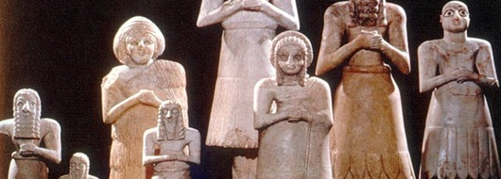
Idolatry
Amr Bin Luhai was the first man to bring an Idol “Hubal” from Syria, placing it in the middle of Ka’aba and summoned people to worship it.

Slide 28
Social Life of Arabs
The Arabian Society presented a social mixture, with different and diverse social level.
Status of Women
Noble and well respected.
Ill treated, disgraced and buried alive after birth.

Slide 29
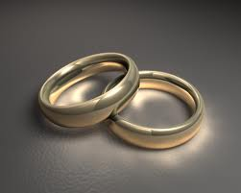
Four Kinds of Marriage
Present day Marriage.
Husband sends his wife to cohabit with another man.
Group of less than ten men would have intercourse with a woman.
A lot of men having intercourse with a woman.

Slide 30
Attachment to Clan
The Bedouin’s were deeply and emotionally attached to their clan.
Their motto was “Support your brother whether he is an oppressor or oppressed”.
Inter-tribal relationships were fragile.

Slide 31
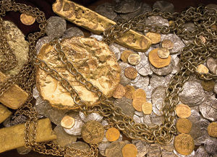
Economic condition of Arabs
The economic condition was equally grave as the social condition.
Professions:
Trade
Industries of knitting
Tannage
Farming
Live stock
Yarn spinning

