Slide 2
Attempts made to check the Onward March of Islam

Slide 7
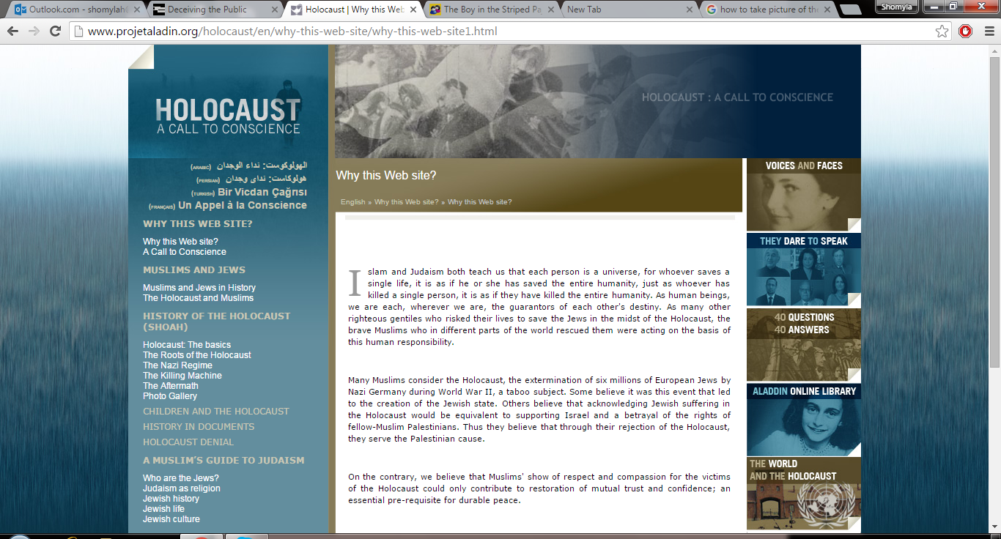

Slide 8
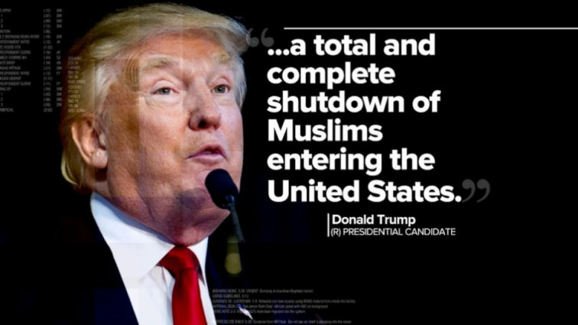

Slide 9
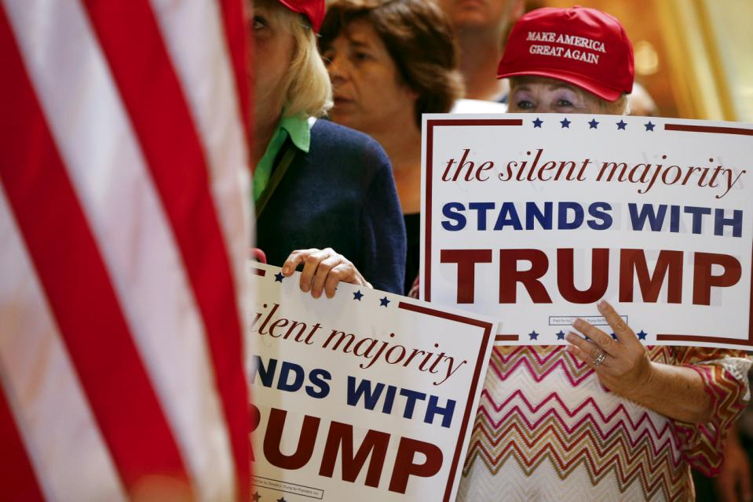

Slide 14
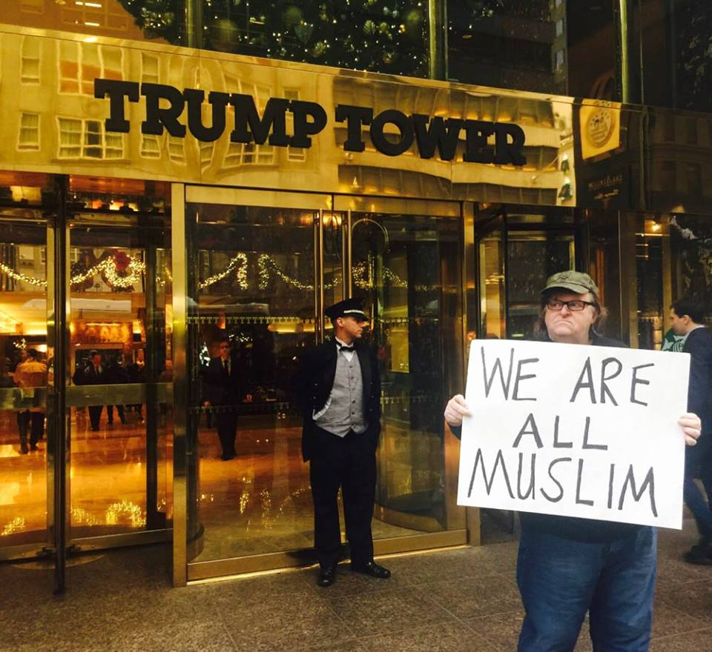

Slide 17
THE FINAL PHASE OF THE DIPLOMACY OF NEGOTIATION:

Slide 18
Prophet (pbuh) offered:
“I invite them to hold fast to a Message that is bound to give them access to kingship over the Arabs and non-Arabs. It is just one word that will give you supremacy over the Arabs and non-Arabs.”
“I want you to testify that there is no god worthy to be worshipped but Allâh, and then divest yourselves of any sort of worship you harbour for any deities other than Allâh.”

