Slide 10
Quraish Approaches Abu Talib

Slide 11
"O my uncle! by Allâh if they put the sun in my right hand and the moon in my left on condition that I abandon this course, until Allâh has made me victorious, or I perish therein, I would not abandon it.”

Slide 12
Once More Quraish Approaches Abu Talib
Abu Talib, of course, turned down all their offers and challenged them to do whatever they pleased.

Slide 13
The Tyrants' Decision To Kill The Prophet
Three Atrocious Attempts

Slide 14
The Tyrants' Decision To Kill The Prophet
Four Atrocious Attempts

Slide 15
The Conversion Of Hamzah Bin 'Abdul-muttalib

Slide 16
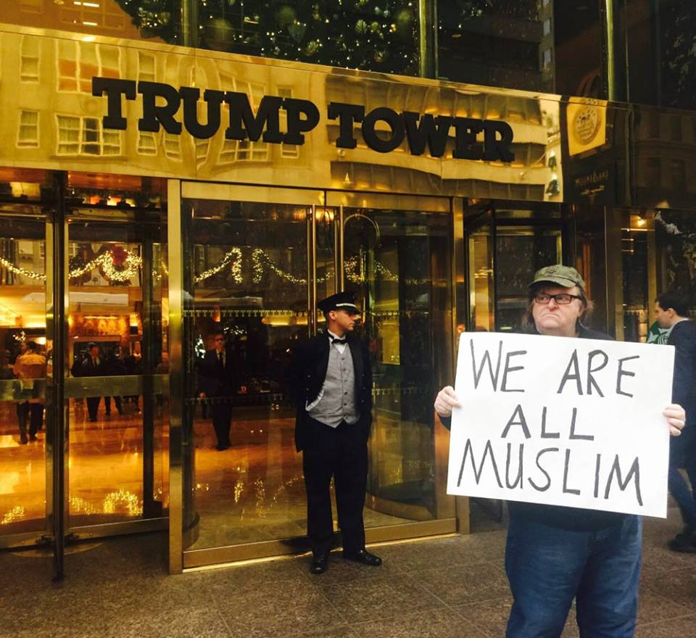

Slide 18
Umar received education in reading and writing. It is related that among the Quraish of Mecca only seventeen persons could read and write, and Umar was one of them.

Slide 19
Umar also acquired matchless skill in the matter of the study of pedigrees.
Umar knew intimately as to who was who among the Quraish.
He was also well versed in the knowledge of the history of Arabia.

Slide 20
Umar was blessed with a strong physique.
He could undergo great rigours.
He could travel on foot for miles.
He was an athlete and a wrestler.

Slide 25
QURAISH'S REPRESENTATIVE NEGOTIATES WITH THE MESSENGER OF ALLAH (pbuh)

Slide 26
ABU TALIB ASSEMBLES BANI HASHIM ND BANI AL-MUTTALIB

